Slide 1
Module V
Process-to-Process Delivery: UDP, TCP, and SCTP

Slide 2
23-1 PROCESS-TO-PROCESS DELIVERY
The transport layer is responsible for process-to- process delivery—the delivery of a packet, part of a message, from one process to another. Two processes communicate in a client/server relationship, as we will see later.
Topics discussed in this section: Client/Server Paradigm Multiplexing and Demultiplexing
Connectionless Versus Connection-Oriented Service Reliable Versus Unreliable
Three Protocols

Slide 3
Note
The transport layer is responsible for process-to-process delivery.
23.3

Slide 4
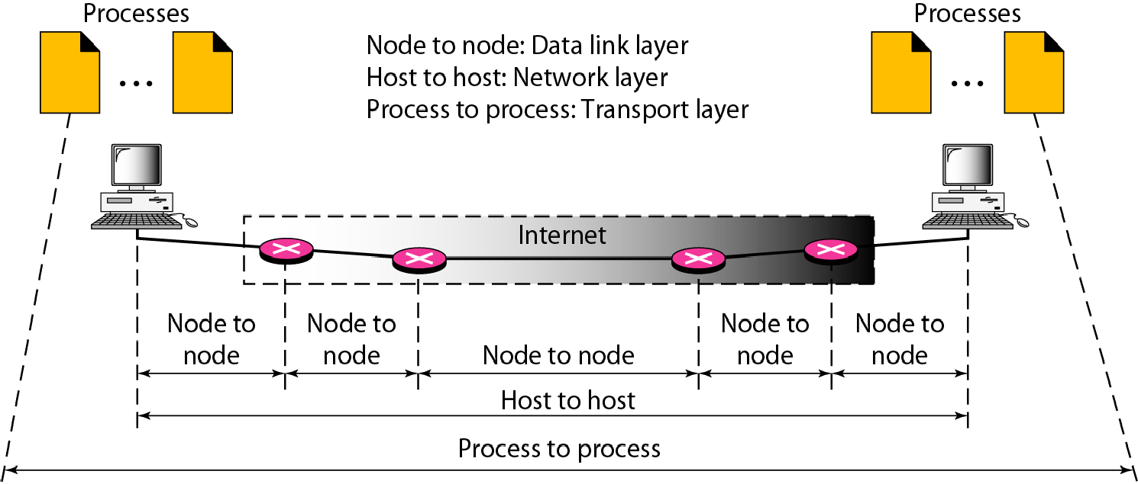
Figure 23.1 Types of data deliveries
23.4

Slide 5
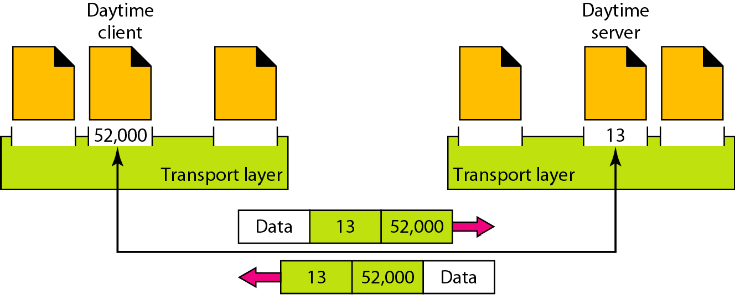
Figure 23.2 Port numbers
23.5

Slide 6
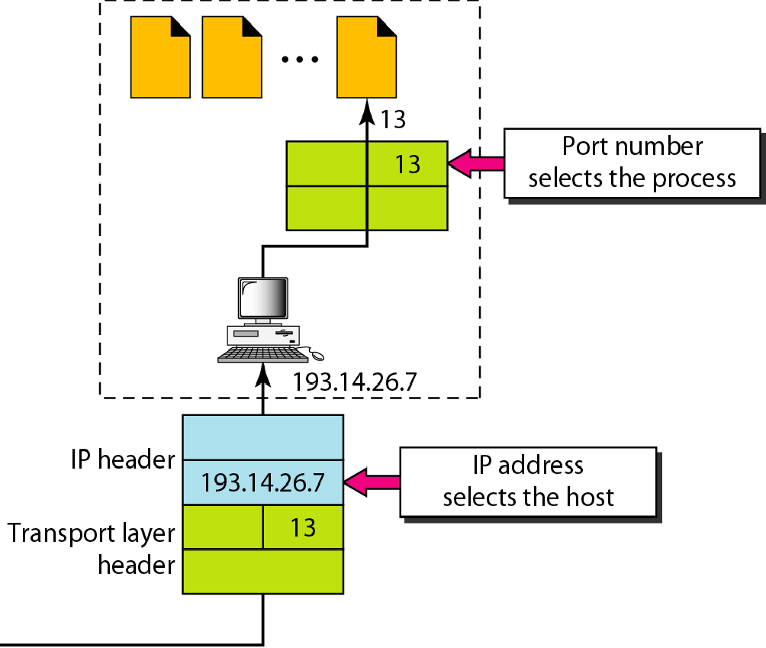
Figure 23.3 IP addresses versus port numbers
23.6

Slide 7
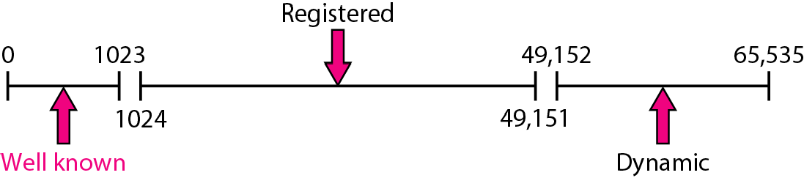
Figure 23.4 IANA ranges
23.7

Slide 8
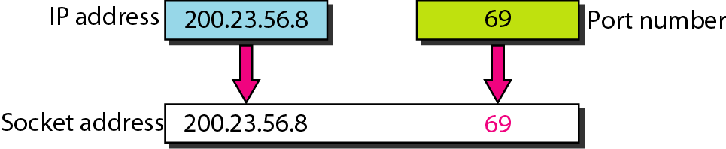
Figure 23.5 Socket address
23.8

Slide 9
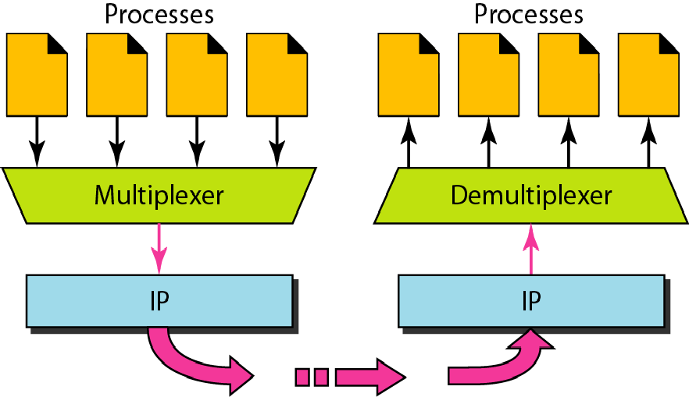
Figure 23.6 Multiplexing and demultiplexing
23.9

Slide 10
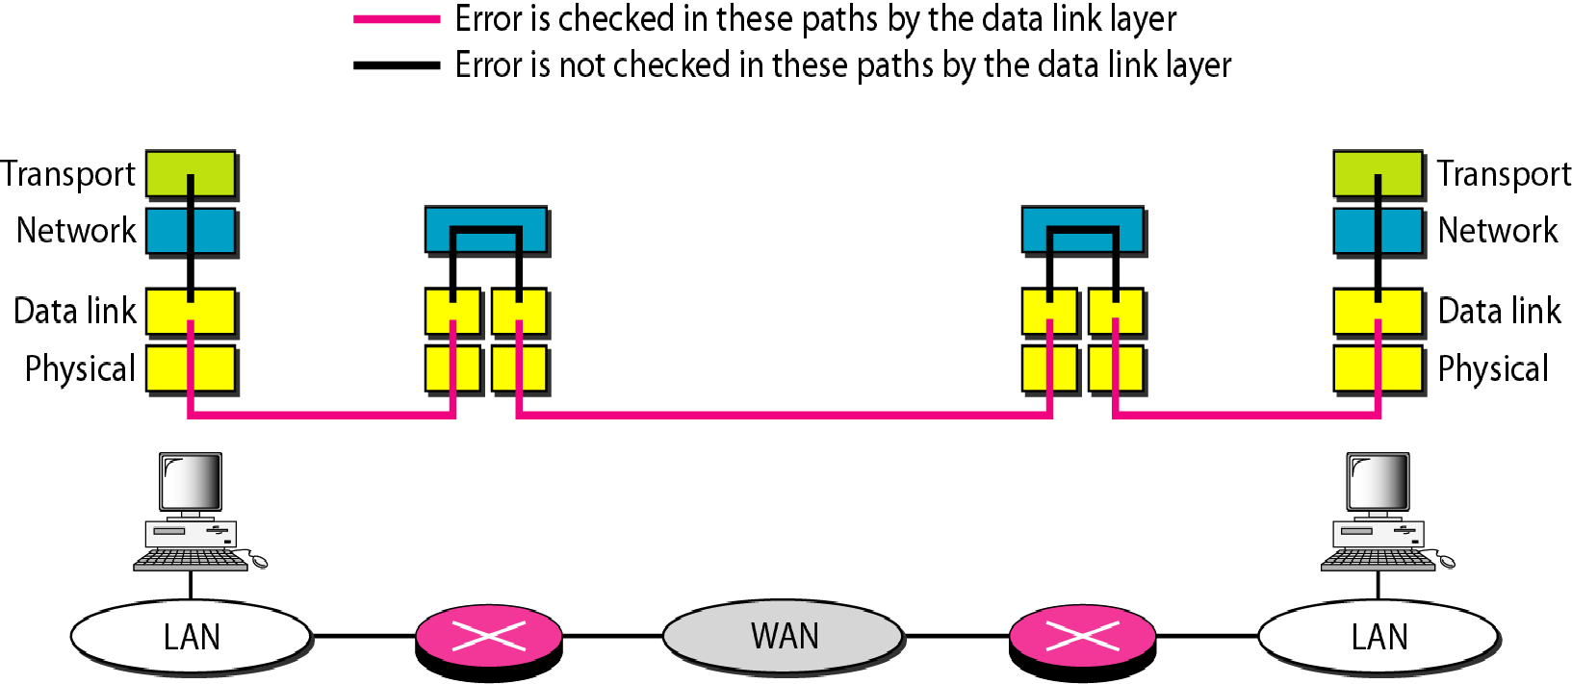
Figure 23.7 Error control

Slide 11
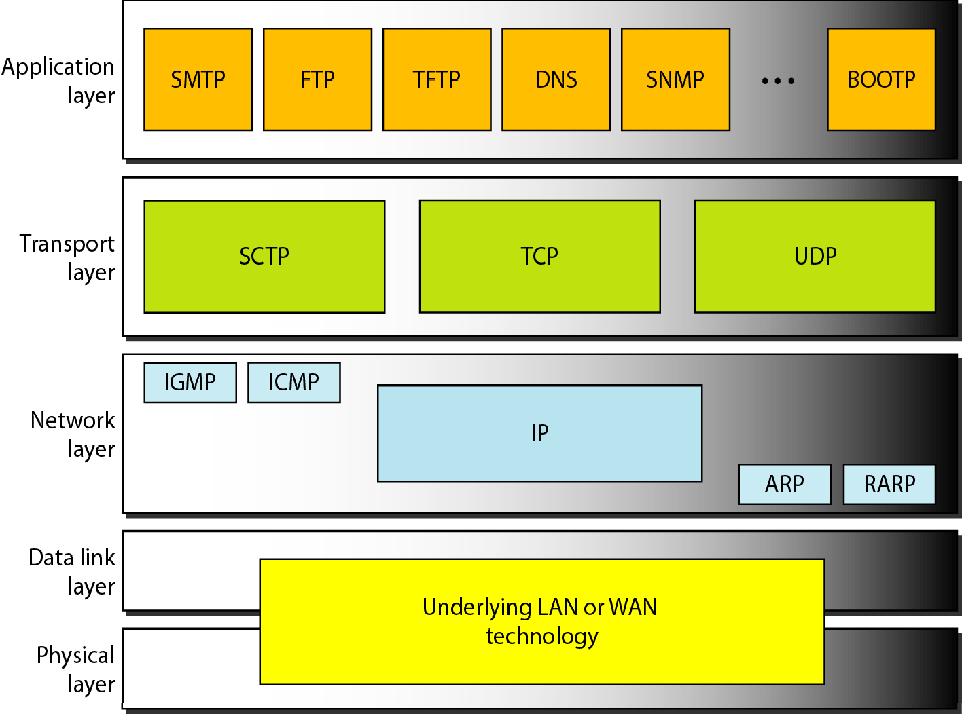
Figure 23.8 Position of UDP, TCP, and SCTP in TCP/IP suite

Slide 12
23-2 USER DATAGRAM PROTOCOL (UDP)
The User Datagram Protocol (UDP) is called a connectionless, unreliable transport protocol. It does not add anything to the services of IP except to provide process-to-process communication instead of host-to- host communication.
Topics discussed in this section:
Well-Known Ports for UDP User Datagram
Checksum UDP Operation Use of UDP

Slide 13
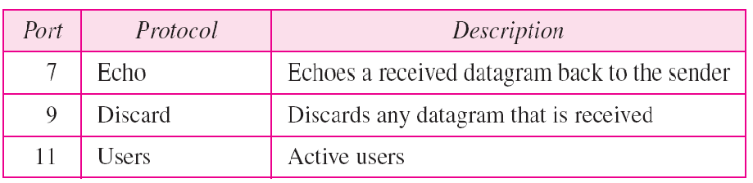
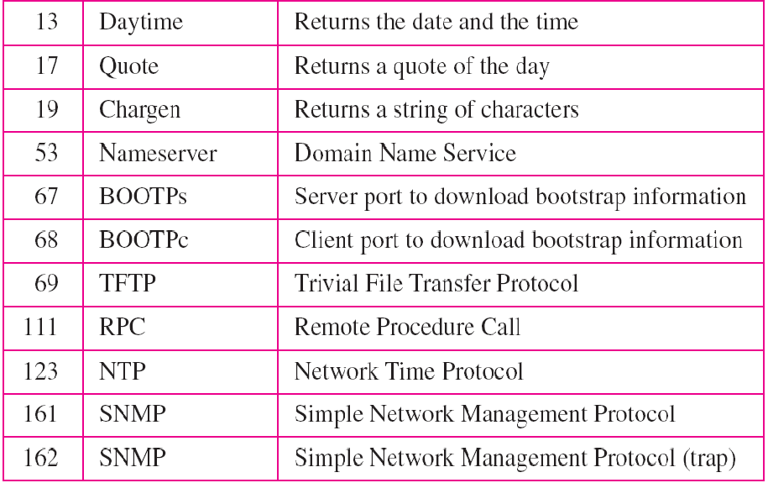
Table 23.1 Well-known ports used with UDP

Slide 14
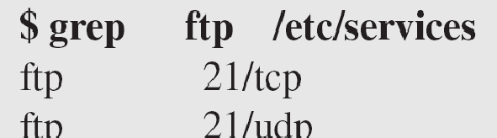
Example 23.1
In UNIX, the well-known ports are stored in a file called
/etc/services Each line in this file gives the name of the server and the well-known port number. We can use the grep utility to extract the line corresponding to the desired application. The following shows the port for FTP. Note that FTP can use port 21 with either UDP or TCP

Slide 15
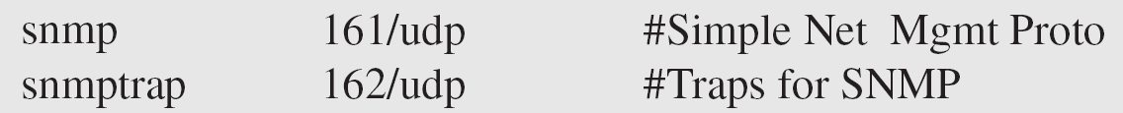
Example 23.1 (continued)
SNMP uses two port numbers (161 and 162), each for a different purpose, as we will see in Chapter 28.

Slide 16
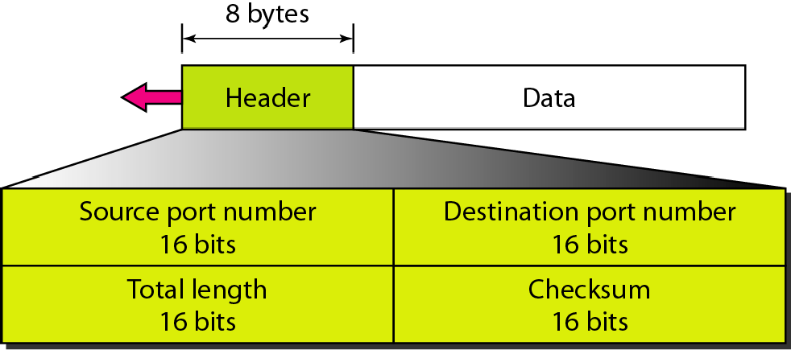
Figure 23.9 User datagram format

Slide 17

Note
UDP length
= IP length – IP header’s length

Slide 18
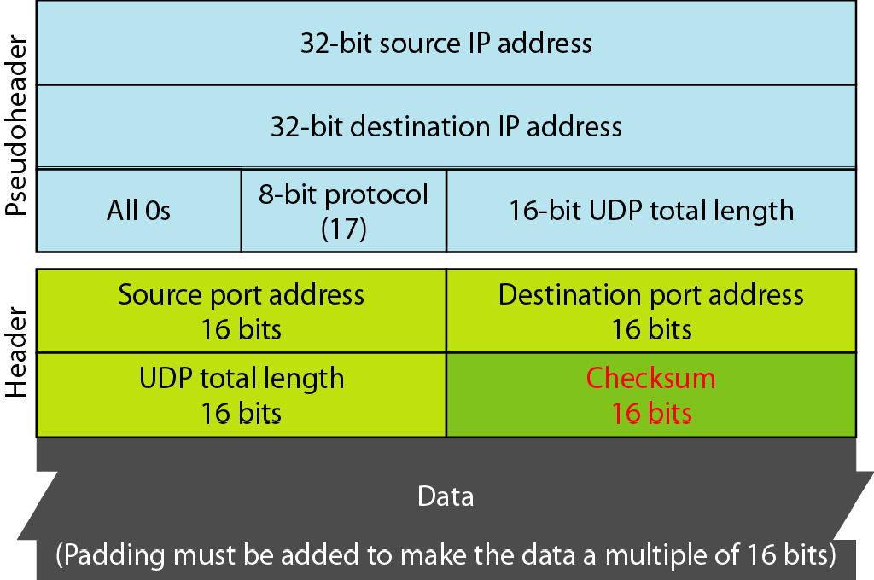
Figure 23.10 Pseudoheader for checksum calculation

Slide 19
Example 23.2
Figure 23.11 shows the checksum calculation for a very small user datagram with only 7 bytes of data. Because the number of bytes of data is odd, padding is added for checksum calculation. The pseudoheader as well as the padding will be dropped when the user datagram is delivered to IP.

Slide 20
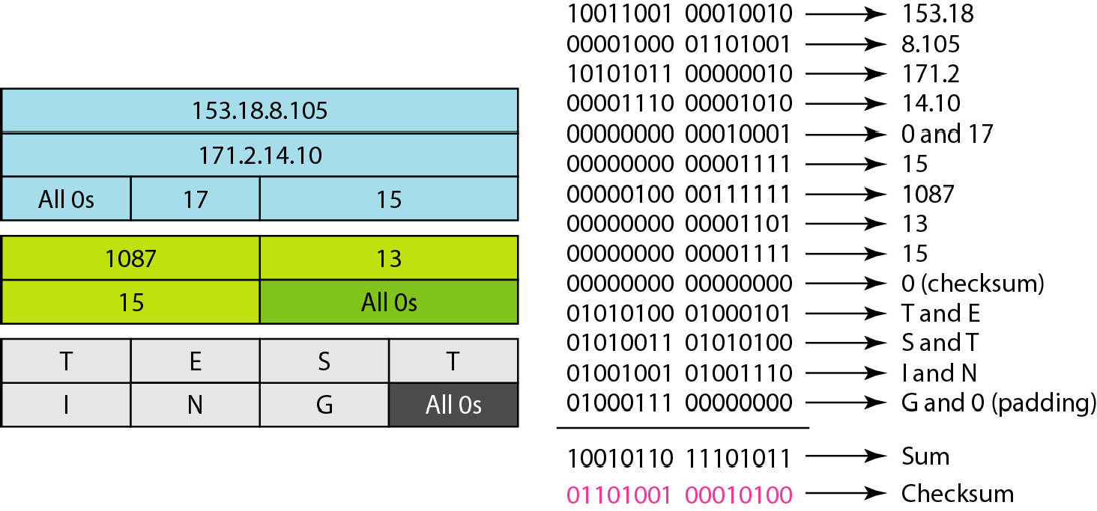
Figure 23.11 Checksum calculation of a simple UDP user datagram

Slide 21
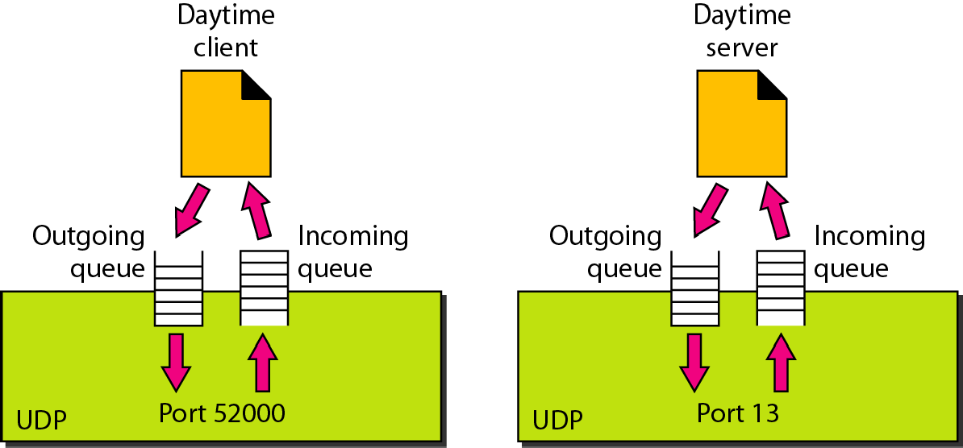
Figure 23.12 Queues in UDP

Slide 22
23-3 TCP
TCP is a connection-oriented protocol; it creates a virtual connection between two TCPs to send data. In addition, TCP uses flow and error control mechanisms at the transport level.
Topics discussed in this section:
TCP Services TCP Features Segment
A TCP Connection Flow Control Error Control

Slide 23
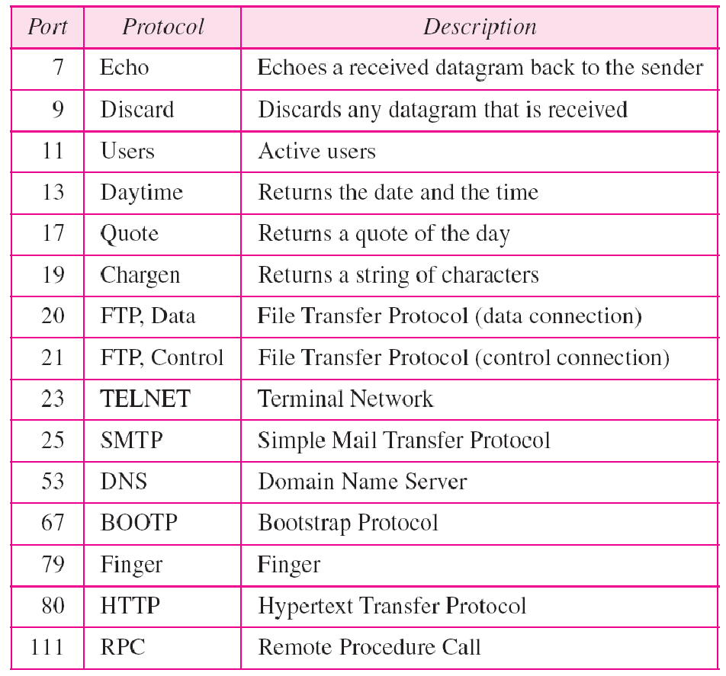
Table 23.2 Well-known ports used by TCP

Slide 24
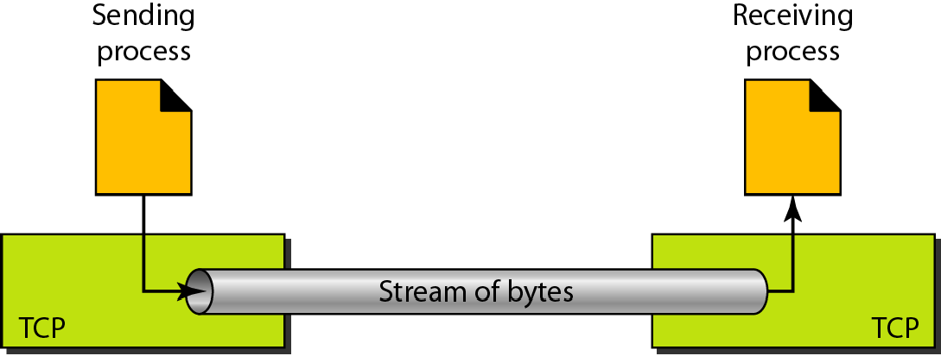
Figure 23.13 Stream delivery

Slide 25
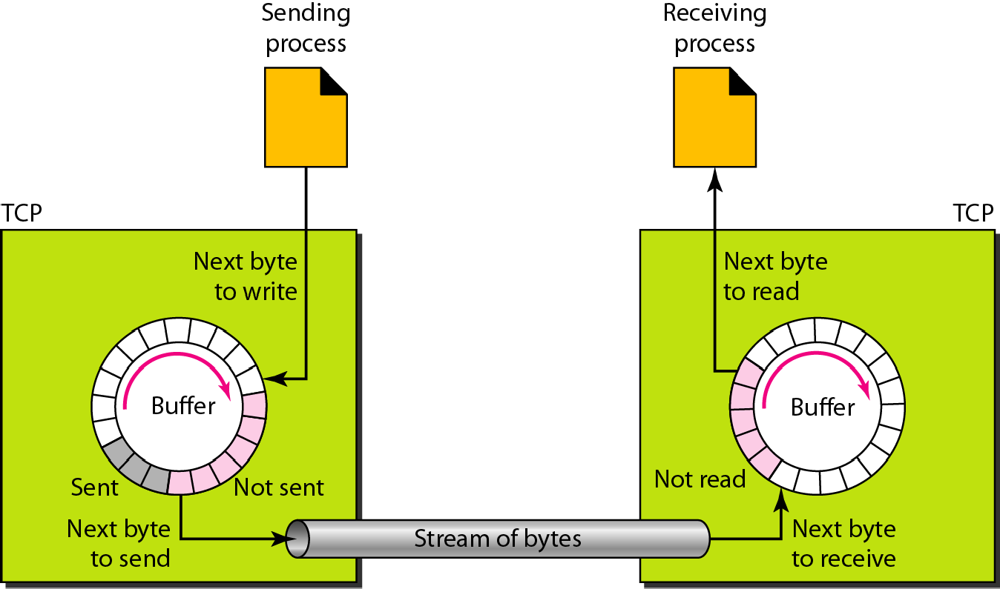
Figure 23.14 Sending and receiving buffers

Slide 26
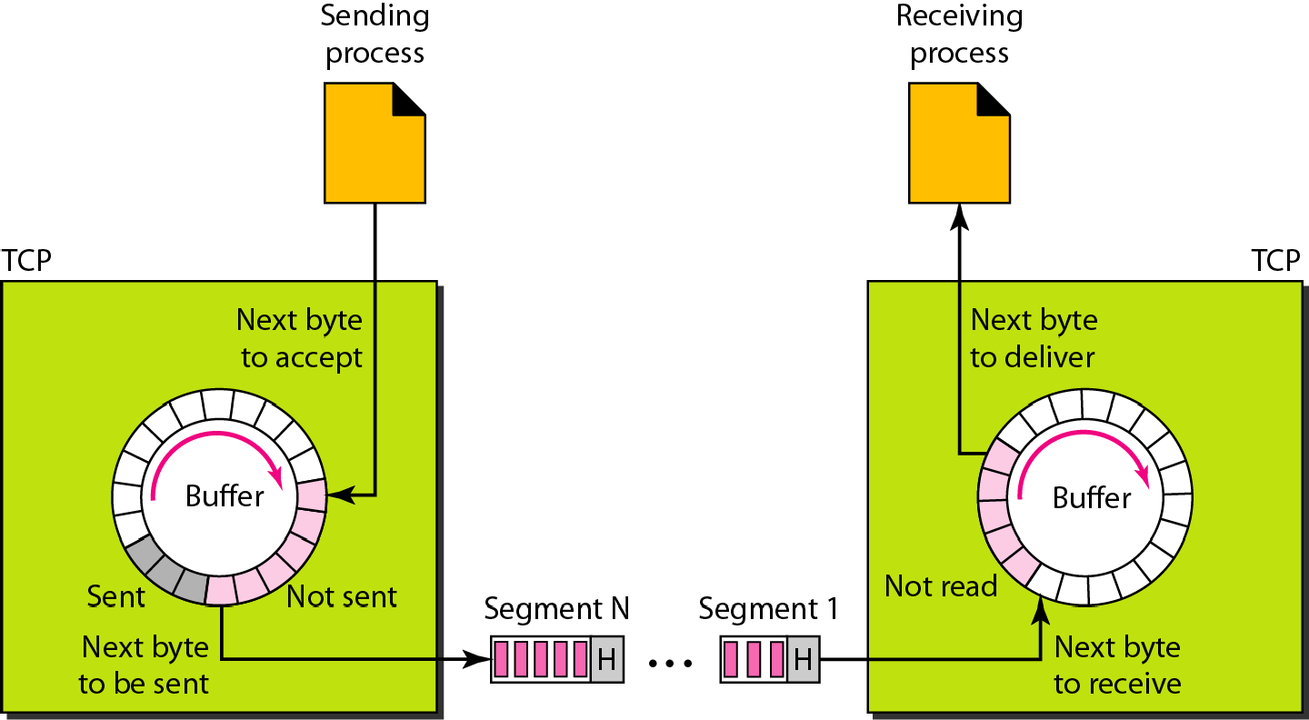
Figure 23.15 TCP segments

Slide 27
Note
The bytes of data being transferred in each connection are numbered by TCP. The numbering starts with a randomly generated number.

Slide 28
Example 23.3
The following shows the sequence number for each segment:

Slide 29

Note
The value in the sequence number field of a segment defines the
number of the first data byte contained in that segment.

Slide 30

Note
The value of the acknowledgment field in a segment defines
the number of the next byte a party expects to receive.
The acknowledgment number is cumulative.

Slide 31
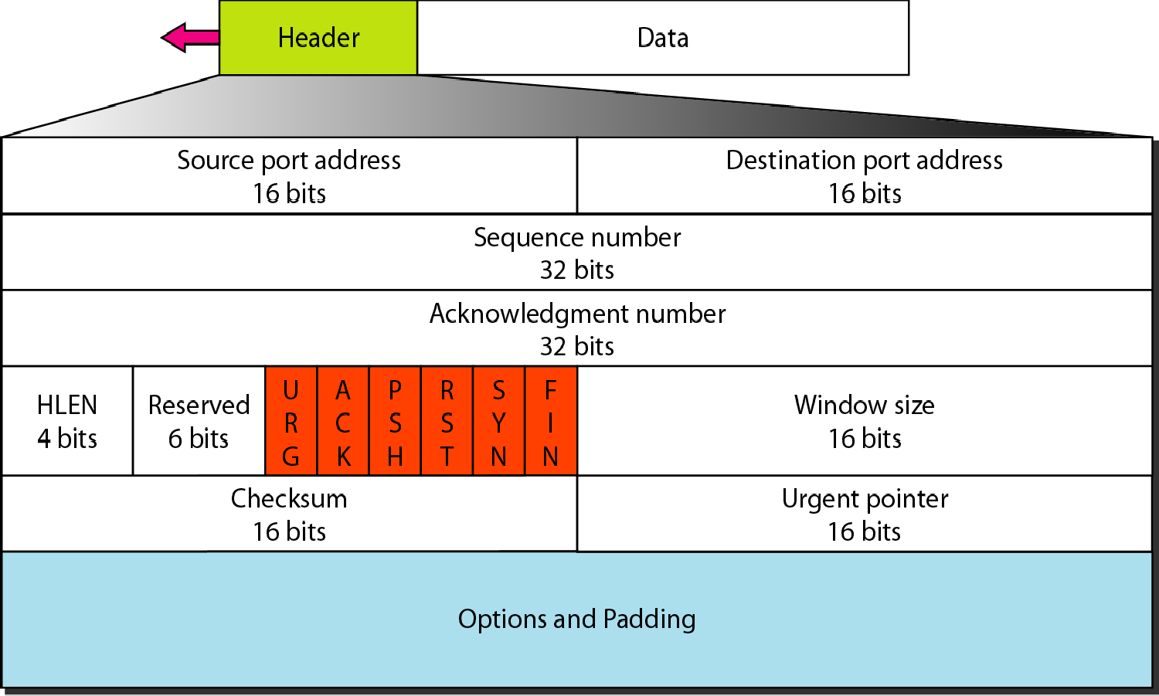
Figure 23.16 TCP segment format

Slide 32
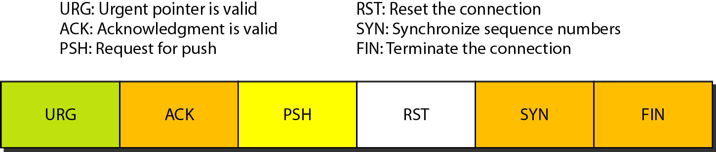
Figure 23.17 Control field

Slide 33
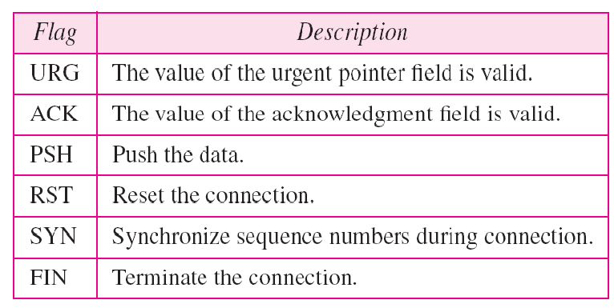
Table 23.3 Description of flags in the control field

Slide 34
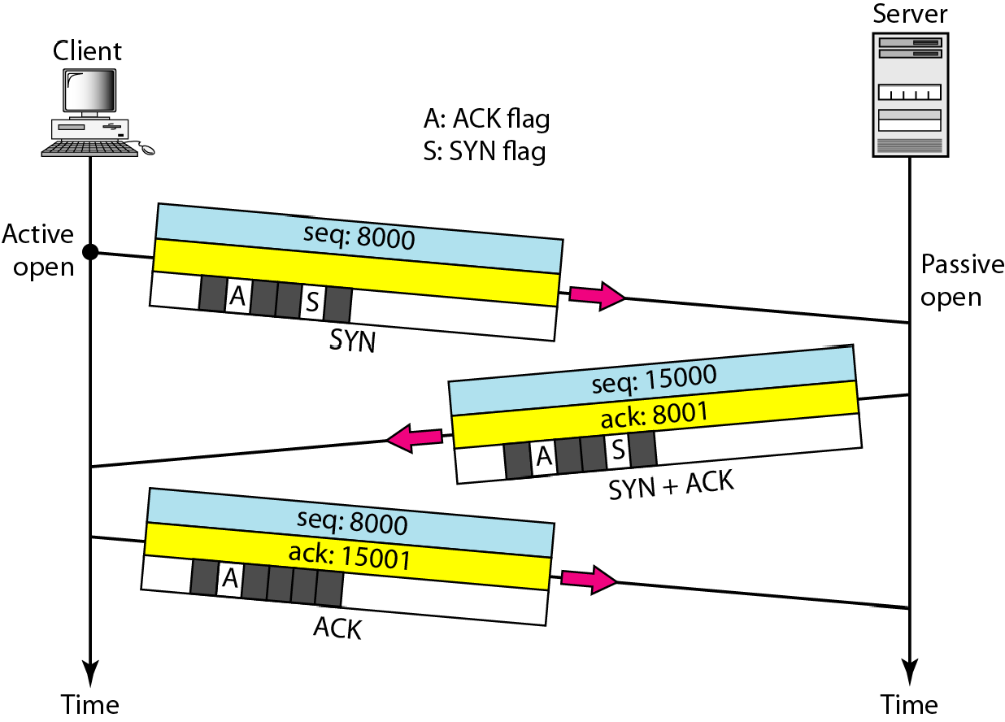
Figure 23.18 Connection establishment using three-way handshaking

Slide 35
Note
A SYN segment cannot carry data, but it consumes one sequence number.

Slide 36
Note
A SYN + ACK segment cannot carry data, but does consume one sequence number.

Slide 37
Note
An ACK segment, if carrying no data, consumes no sequence number.

Slide 38
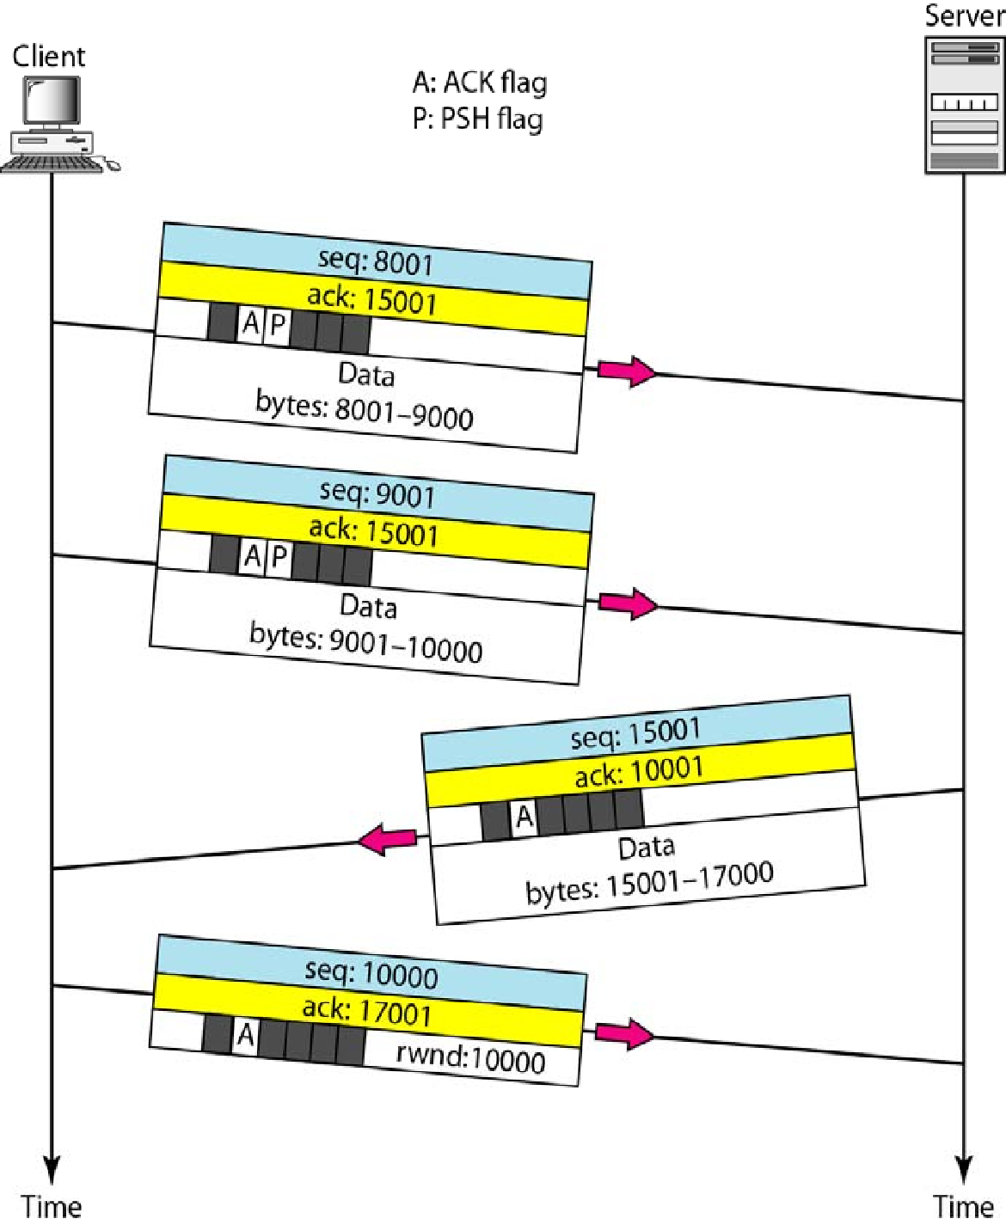
Figure 23.19 Data transfer

Slide 39
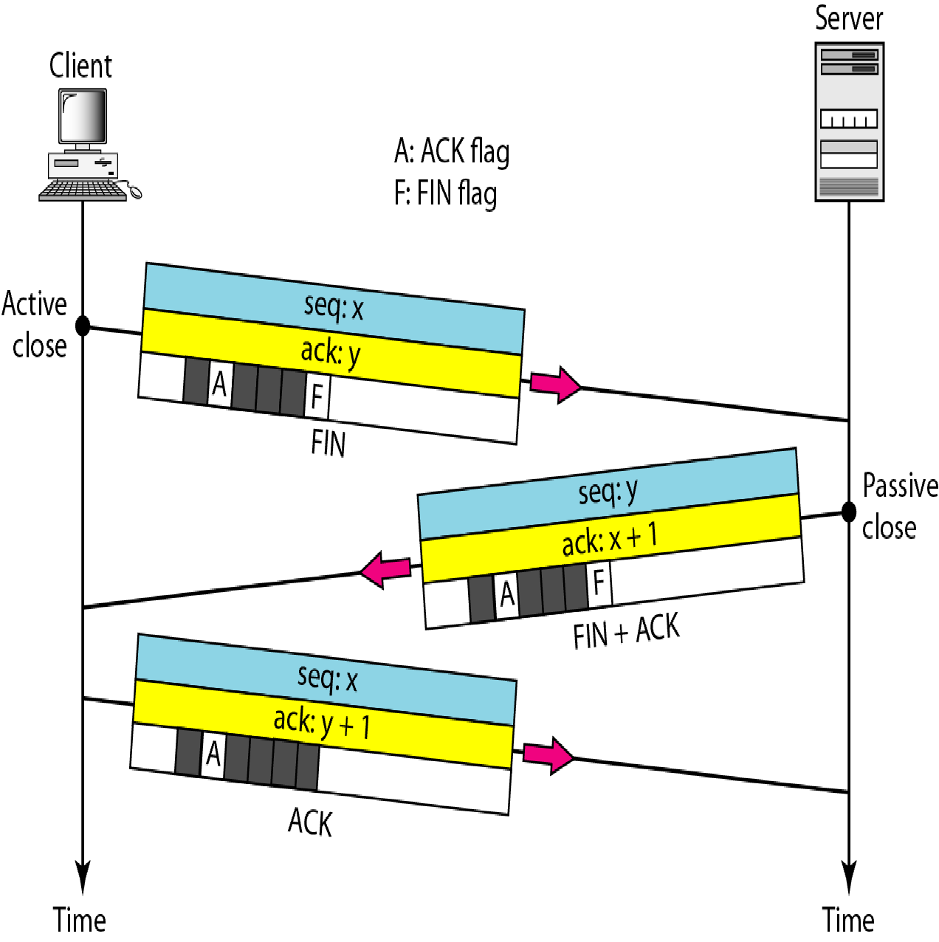
Figure 23.20 Connection termination using three-way handshaking

Slide 40
Note
The FIN segment consumes one sequence number if it does
not carry data.

Slide 41
Note
The FIN + ACK segment consumes one sequence number if it
does not carry data.

Slide 42
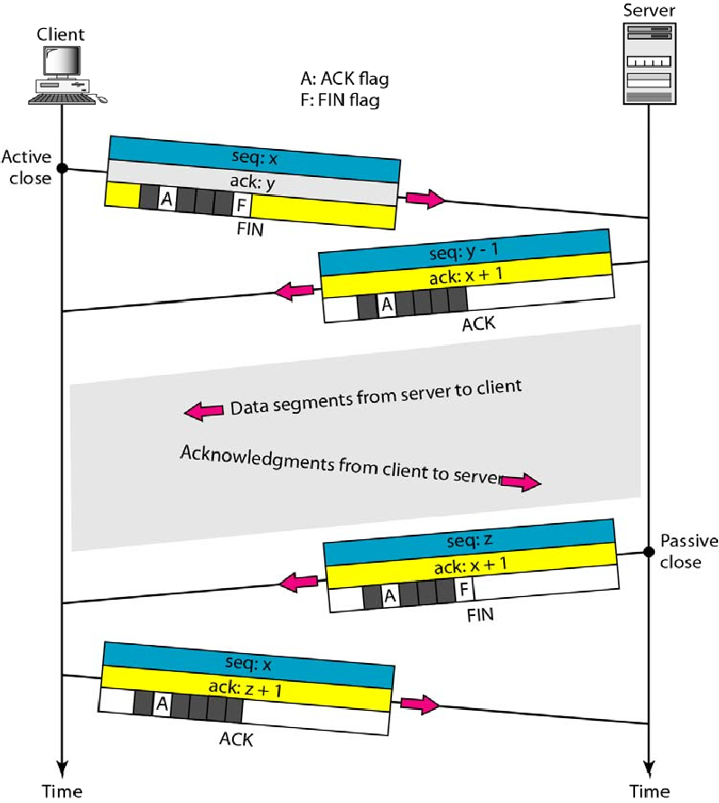
Figure 23.21 Half-close

Slide 43
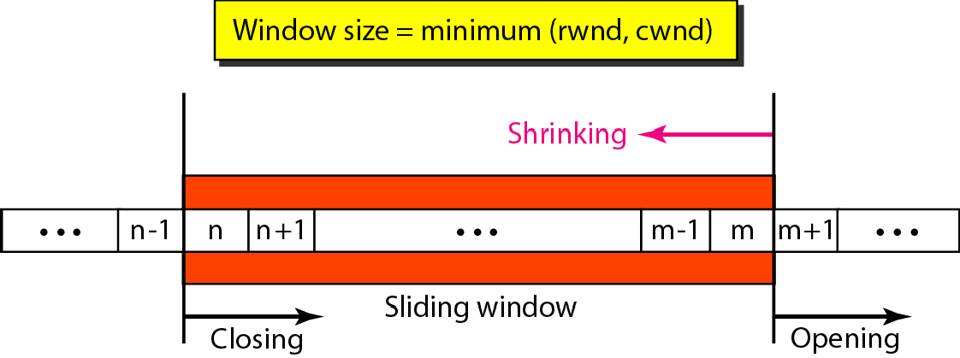
Figure 23.22 Sliding window

Slide 44

Note
A sliding window is used to make transmission more efficient as well as to control the flow of data so that the destination does not become overwhelmed with data.
TCP sliding windows are byte-oriented.

Slide 45
Example 23.4
What is the value of the receiver window (rwnd) for host A if the receiver, host B, has a buffer size of 5000 bytes and 1000 bytes of received and unprocessed data?
Solution
The value of rwnd = 5000 − 1000 = 4000. Host B can receive only 4000 bytes of data before overflowing its buffer. Host B advertises this value in its next segment to A.

Slide 46
Example 23.5
What is the size of the window for host A if the value of rwnd is 3000 bytes and the value of cwnd is 3500 bytes?
Solution
The size of the window is the smaller of rwnd and cwnd, which is 3000 bytes.

Slide 47
Example 23.6
Figure 23.23 shows an unrealistic example of a sliding window. The sender has sent bytes up to 202. We assume that cwnd is 20 (in reality this value is thousands of bytes). The receiver has sent an acknowledgment number of 200 with an rwnd of 9 bytes (in reality this value is thousands of bytes). The size of the sender window is the minimum of rwnd and cwnd, or 9 bytes. Bytes 200 to 202 are sent, but not acknowledged. Bytes 203 to 208 can be sent without worrying about acknowledgment. Bytes 209 and above cannot be sent.

Slide 48
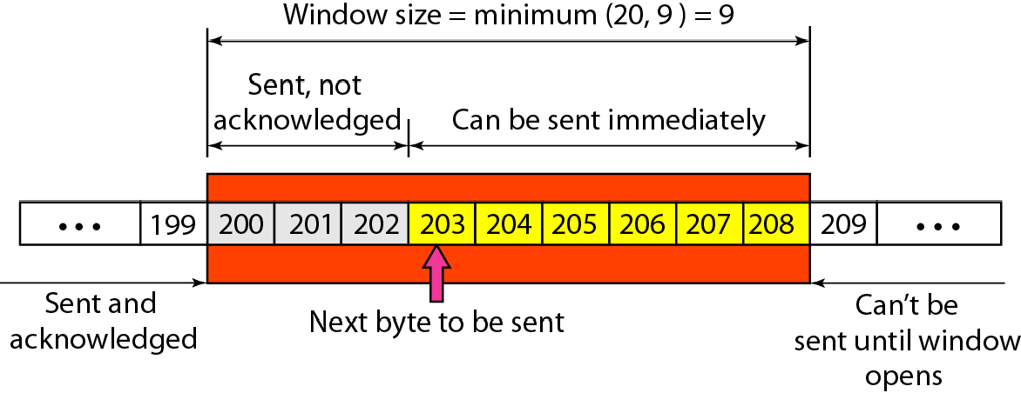
Figure 23.23 Example 23.6

Slide 49
Note
Some points about TCP sliding windows:
The size of the window is the lesser of rwnd and cwnd.
The source does not have to send a full window’s worth of data.
The window can be opened or closed by the receiver, but should not be shrunk.
The destination can send an acknowledgment at any time as long as it does not result in a shrinking
window.
The receiver can temporarily shut down the window; the sender, however, can always send a segment of 1 byte after the window is shut down.

Slide 50
Note
ACK segments do not consume sequence numbers and are not acknowledged.

Slide 51
Note
In modern implementations, a retransmission occurs if the retransmission timer expires or three duplicate ACK segments have arrived.

Slide 52
Note
No retransmission timer is set for an ACK segment.

Slide 53
Note
Data may arrive out of order and be temporarily stored by the receiving TCP, but TCP guarantees that no out-of-order segment is delivered to the process.

Slide 54
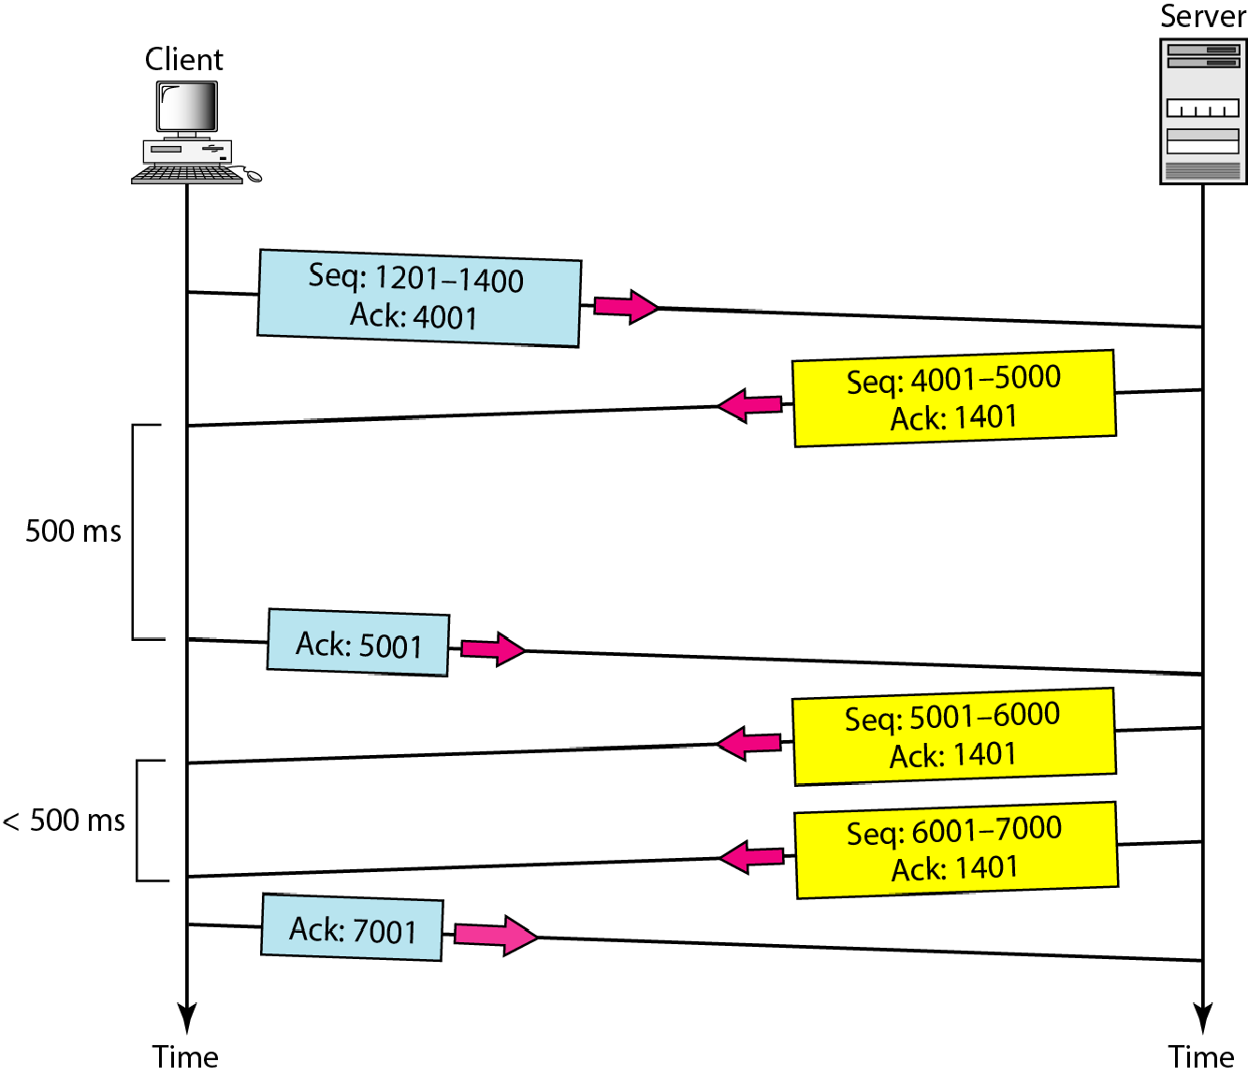
Figure 23.24 Normal operation

Slide 55
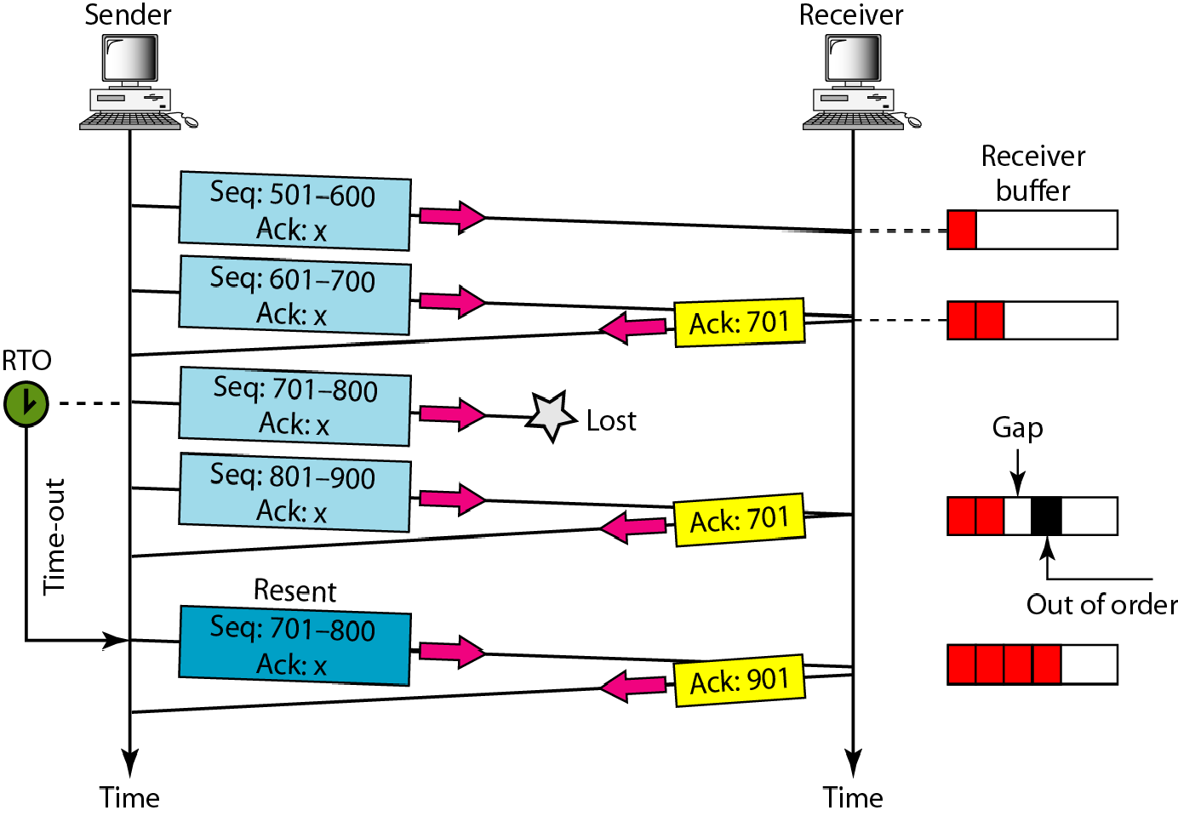
Figure 23.25 Lost segment

Slide 56
Note
The receiver TCP delivers only ordered data to the process.

Slide 57
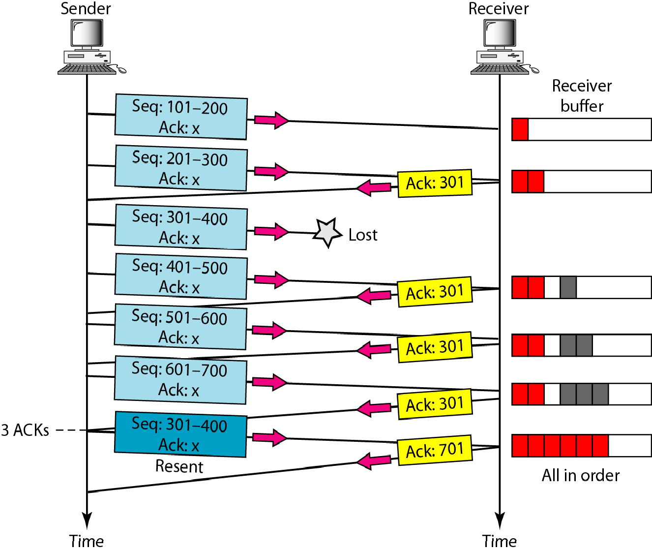
Figure 23.26 Fast retransmission

Slide 58
23-4 SCTP
Stream Control Transmission Protocol (SCTP) is a new reliable, message-oriented transport layer
protocol.. SCTP, Internet
however, is
mostl have
designed for recently been
applications
that
introduced.. These
new applications need a more
sophisticated service than TCP can provide. Topics discussed in this section:
SCTP Services and Features Packet Format
An SCTP Association
Flow Control and Error Control

Slide 59
Note
SCTP is a message-oriented, reliable protocol that combines the best features of UDP and TCP.

Slide 60
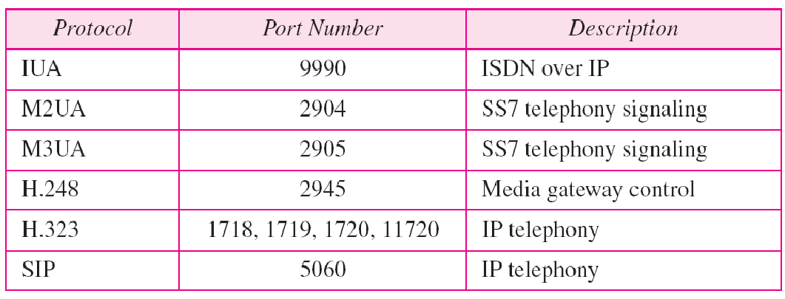
Table 23.4 Some SCTP applications

Slide 61
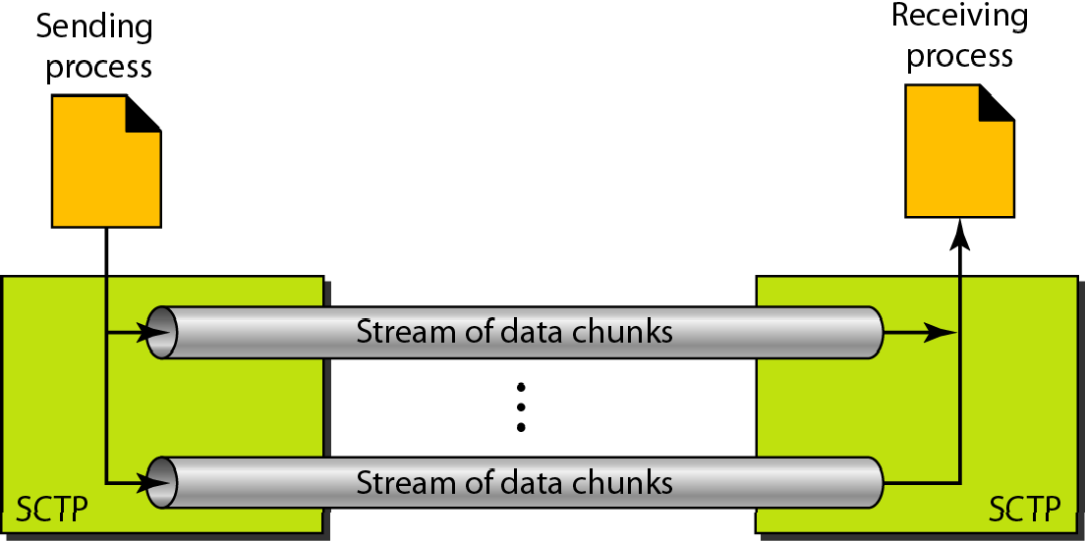
Figure 23.27 Multiple-stream concept

Slide 62
Note
An association in SCTP can involve multiple streams.

Slide 63
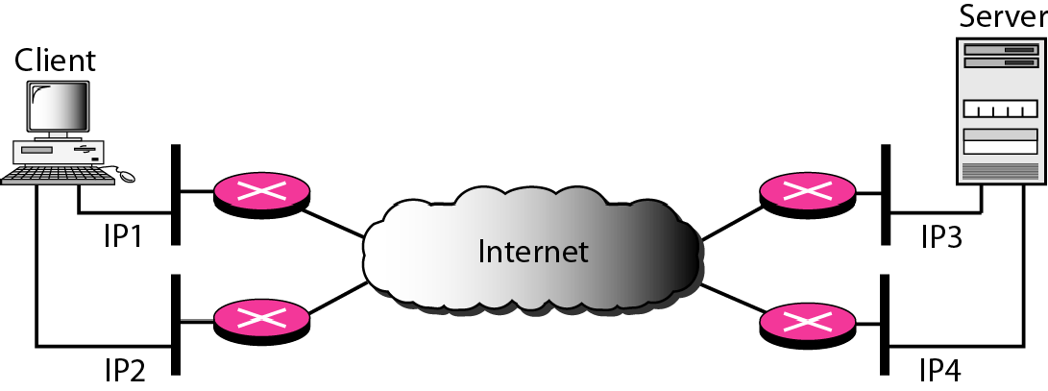
Figure 23.28 Multihoming concept

Slide 64
Note
SCTP association allows multiple IP addresses for each end.

Slide 65
Note
In SCTP, a data chunk is numbered using a TSN.

Slide 66
Note
To distinguish between different streams, SCTP uses an SI.

Slide 67
Note
To distinguish between different data chunks belonging to the same stream, SCTP uses SSNs.

Slide 68
Note
TCP has segments; SCTP has packets.

Slide 69
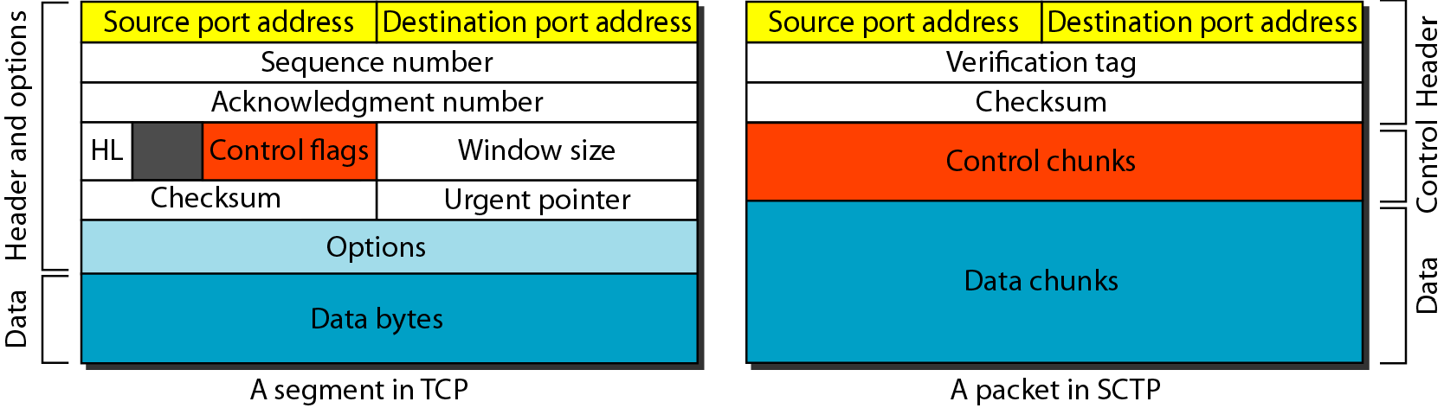
Figure 23.29 Comparison between a TCP segment and an SCTP packet

Slide 70
Note
In SCTP, control information and data information are carried in separate chunks.

Slide 71
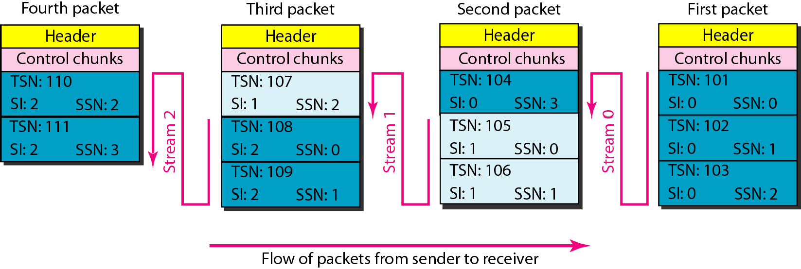
Figure 23.30 Packet, data chunks, and streams

Slide 72
Note
Data chunks are identified by three items: TSN, SI, and SSN.
TSN is a cumulative number identifying the association; SI defines the stream;
SSN defines the chunk in a stream.

Slide 73
Note
In SCTP, acknowledgment numbers are used to acknowledge only data chunks; control chunks are acknowledged by other control chunks if necessary.

Slide 74
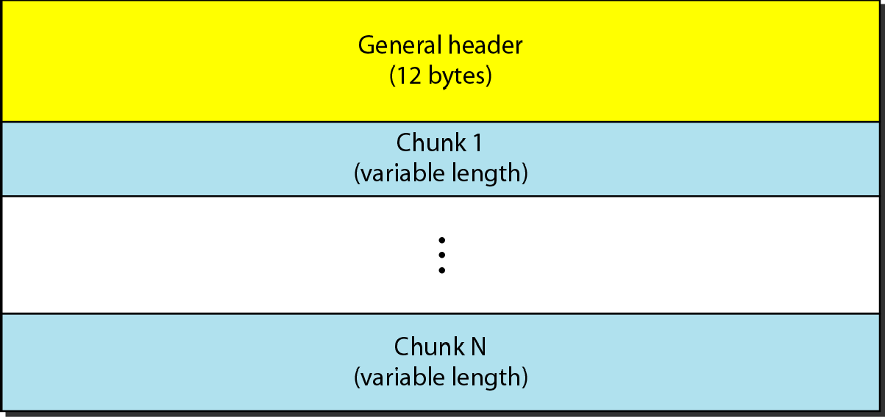
Figure 23.31 SCTP packet format

Slide 75
Note
In an SCTP packet, control chunks come before data chunks.

Slide 76
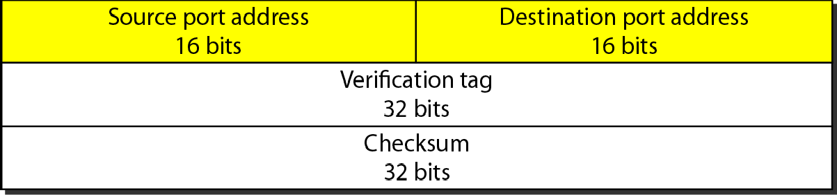
Figure 23.32 General header

Slide 77
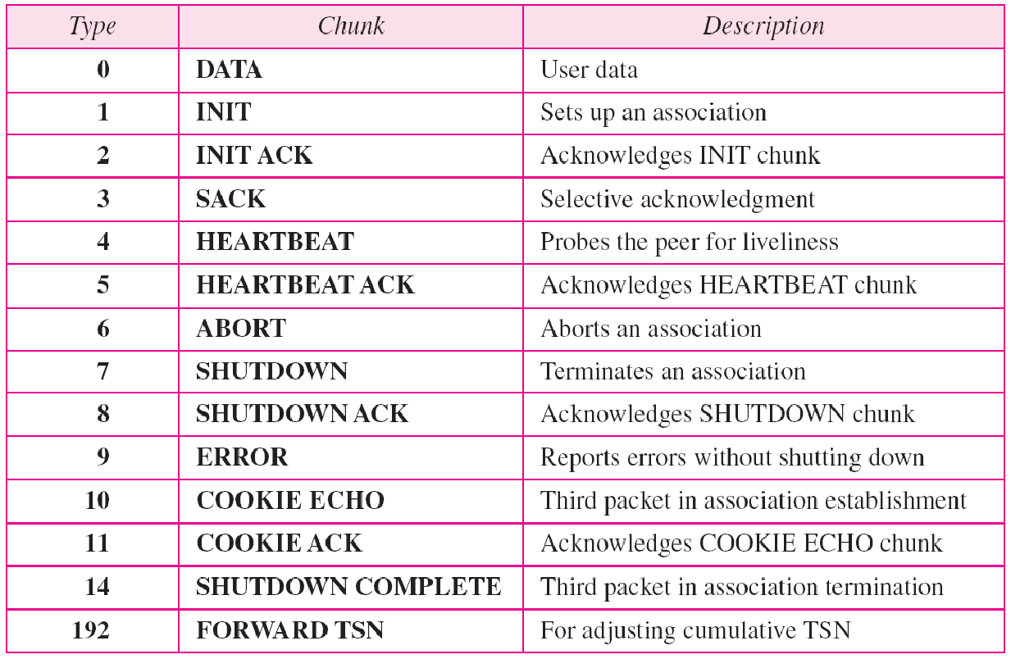
Table 23.5 Chunks

Slide 78
Note
A connection in SCTP is called an association.

Slide 79
Note
No other chunk is allowed in a packet carrying an INIT or INIT ACK chunk.
A COOKIE ECHO or a COOKIE ACK
chunk can carry data chunks.

Slide 80
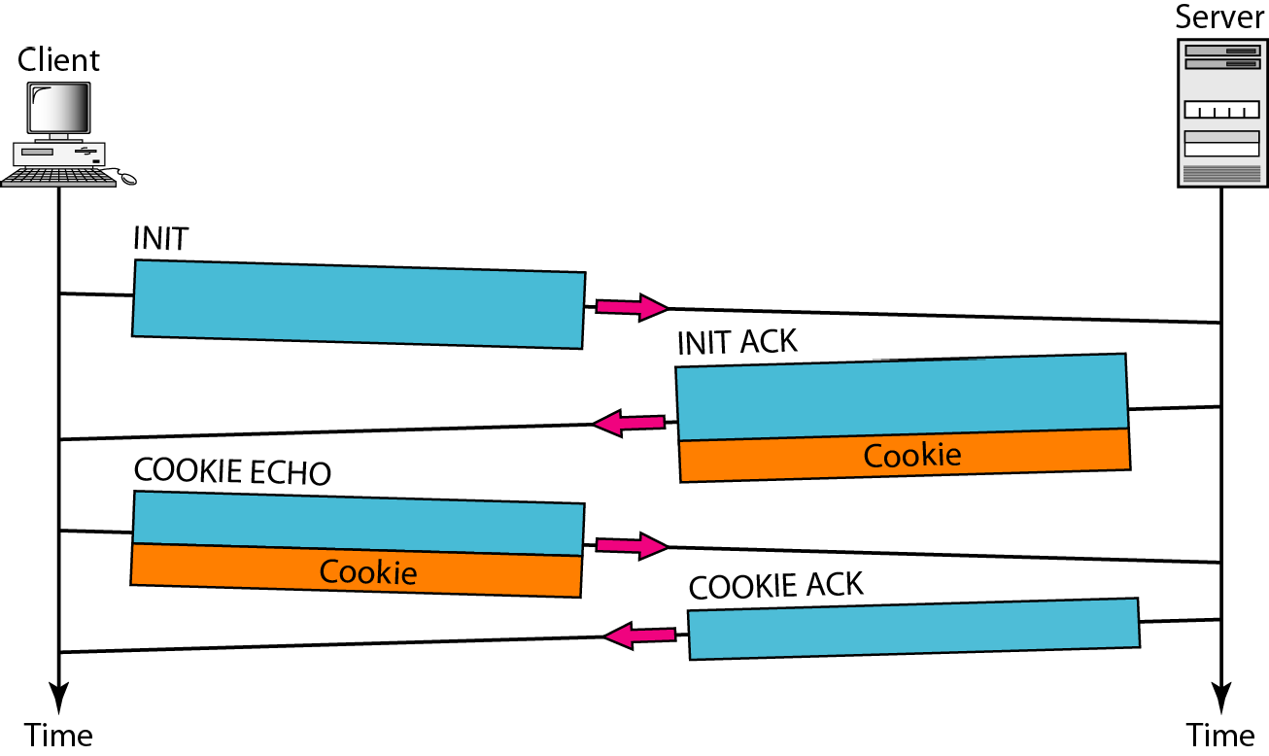
Figure 23.33 Four-way handshaking

Slide 81
Note
In SCTP, only DATA chunks consume TSNs;
DATA chunks are the only chunks that are acknowledged.

Slide 82
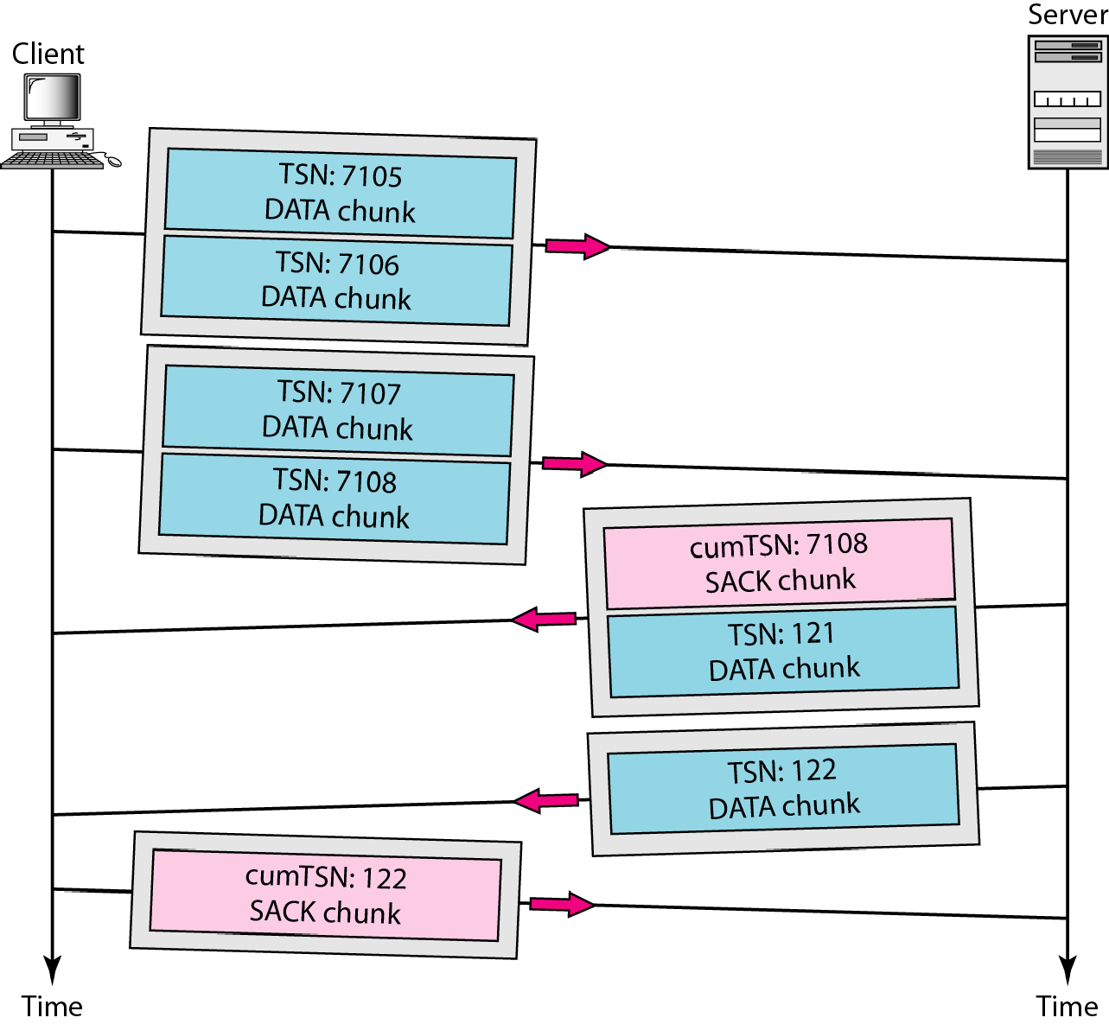
Figure 23.34 Simple data transfer

Slide 83
Note
The acknowledgment in SCTP defines the cumulative TSN, the TSN of the last data chunk received in order.

Slide 84
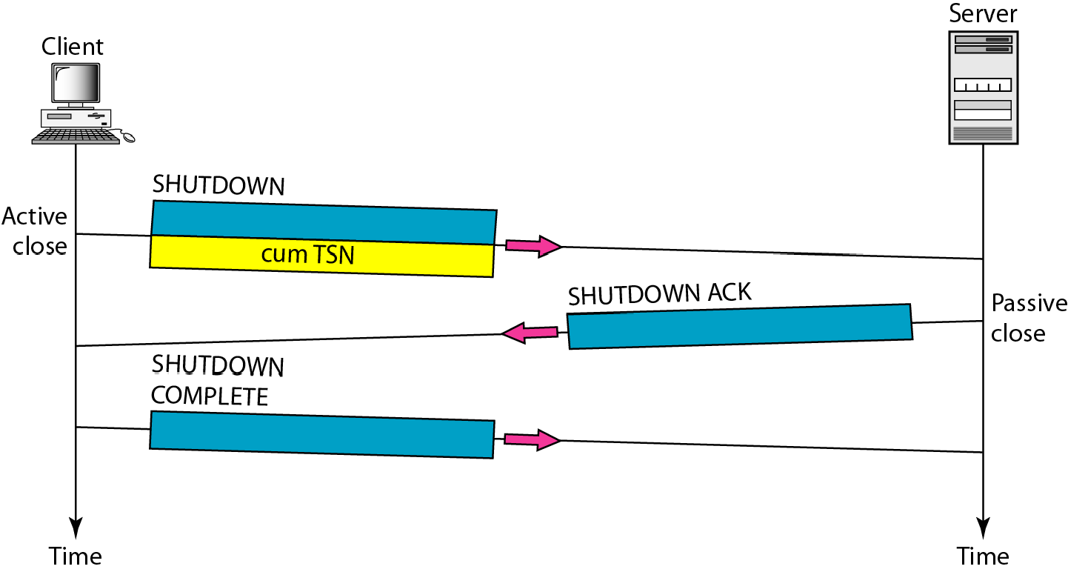
Figure 23.35 Association termination

Slide 85
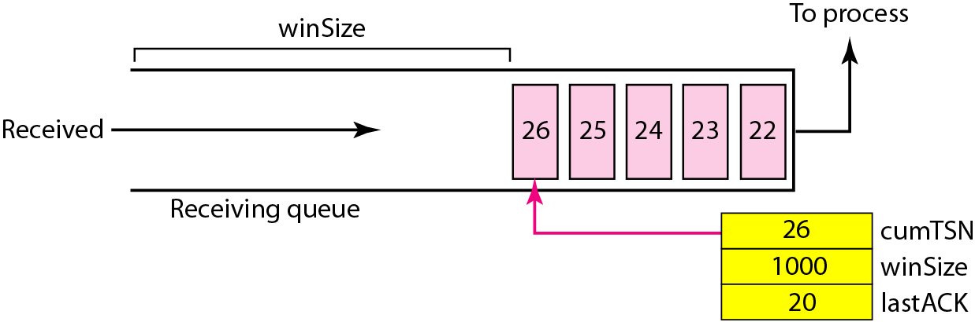
Figure 23.36 Flow control, receiver site

Slide 86
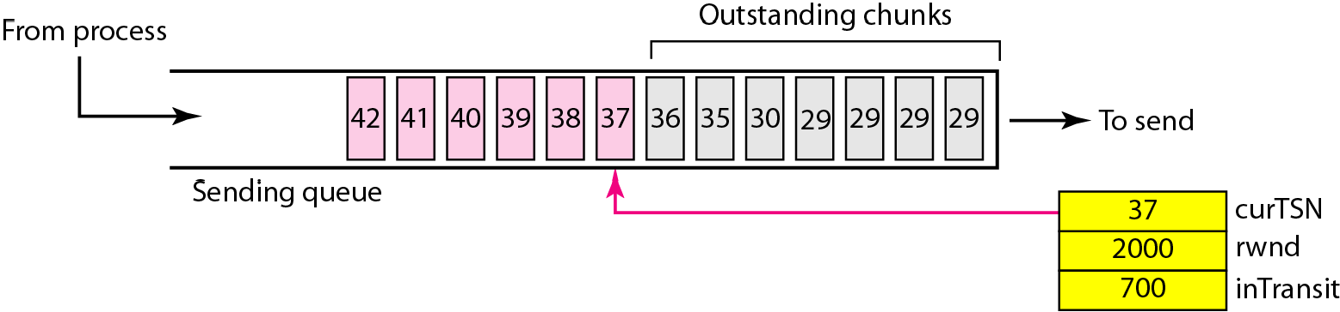
Figure 23.37 Flow control, sender site

Slide 87
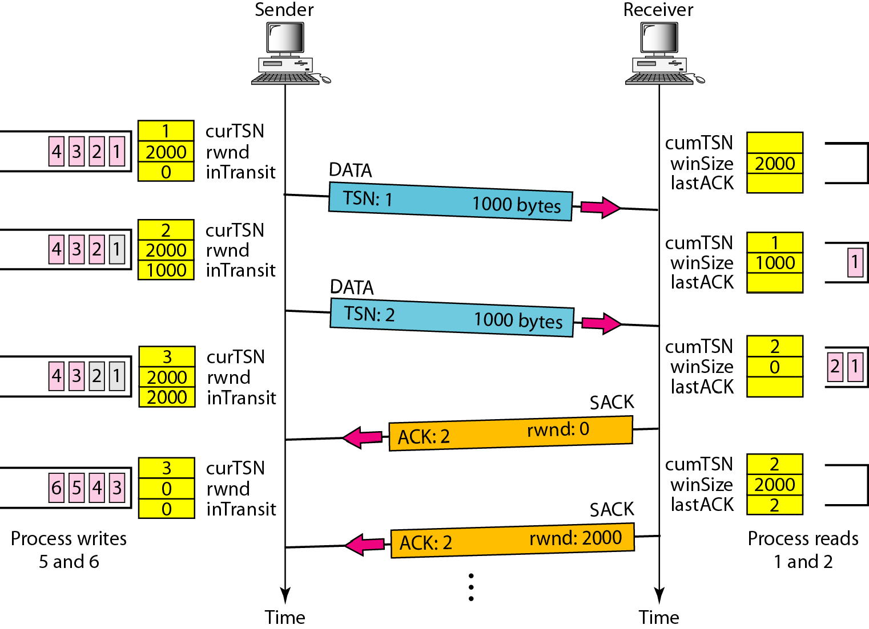
Figure 23.38 Flow control scenario

Slide 88
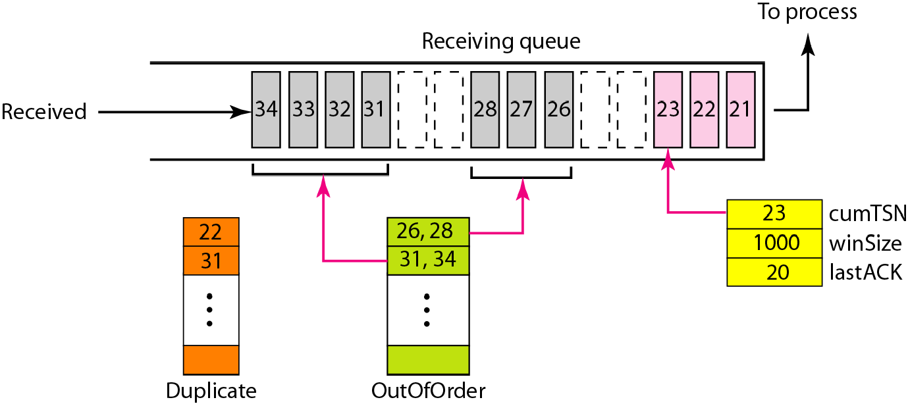
Figure 23.39 Error control, receiver site

Slide 89
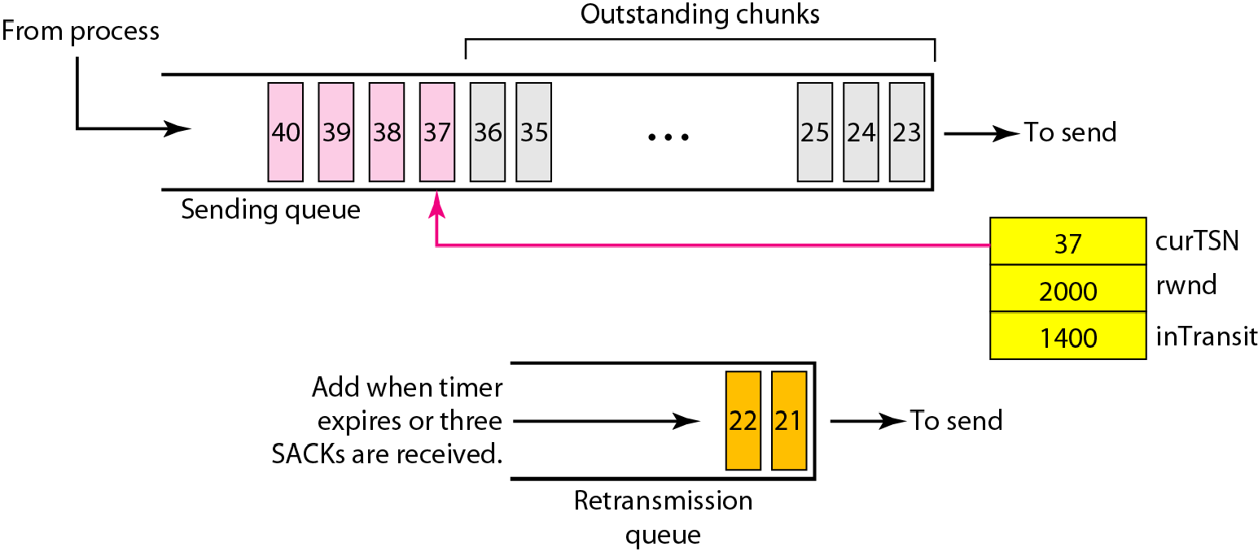
Figure 23.40 Error control, sender site

